Slide 1

AUDIENCE
The audience of this PowerPoint can range from enumerators to RAM and Programme staff in various offices. It can also be used for the training of partners or service providers.
Slide sections have been inserted to assist in the selection of material.

Slide 2
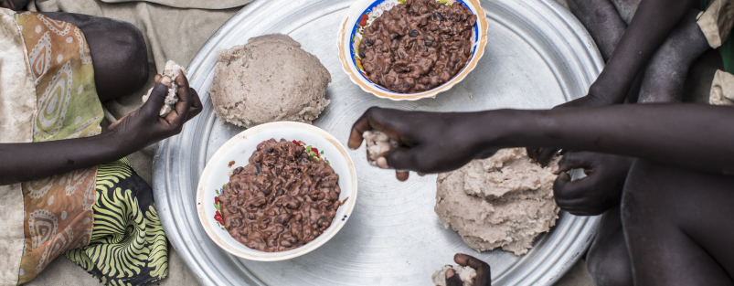

Food Consumption Score (FCS)
Needs Assessments & Targeting Unit
2023 February

Slide 3
Introduction

Slide 4
FCS: training instructions 1
Discuss the objectives of the module, i.e., to gain information on the food consumption of households in the targeted population. Explain the role of this indicator in food insecurity figures and the use of information, internally and externally. This gives the enumerators a clear understanding of the importance of the data they would be soon collecting.

Slide 5
FCS: What is it?
The Food Consumption Score (FCS) is a composite score based on households’ dietary diversity, food frequency & the relative nutritional importance of the food consumed.
  Dietary Diversity: number of individual foods consumed over a reference period.
  Food frequency: number of days (in the past 7 days) that a specific food item has been consumed.
  Nutritional importance: food groups are weighted to reflect their nutritional importance.
The FCS is highly correlated with other food security proxy indicators, including the Household Dietary Diversity Score, reduced Coping Strategies Index, and Vitamin A, Protein-rich and Hem Iron intake.

Slide 6
FCS: USEs OF this indicator
The FCS can be used in a range of ways, including for programme activity monitoring, determining the food security situation, and population-level targeting.
The FCS indicator plays a part in classifying households according to their level of food security, through Consolidated Approach for Reporting on food Insecurity (CARI).
This FCS is one of the food security outcome indicators in the Integrated Food Security Phase Classification (IPC) acute food insecurity reference table.

Slide 7
FCS: food frequency
Some important definitions to consider….
Food group is defined as a grouping of food items that have similar caloric and nutrient content.
Food items cannot be further split into separate foods. However, generic terms such as ‘rice’ or ‘tomatoes’ are generally considered to be food items for this analysis.
Condiment, in this context, refers to a food that is generally eaten in a very small quantity, often just for flavour. An example would be a ‘pinch’ of fish powder, a teaspoon of milk in tea, spices, etc.
Dietary diversity is defined as the number of different foods or food groups eaten over a reference time, not regarding the frequency of consumption.
Food frequency, in this context, is defined as the frequency (in terms of days of consumption over a reference period) that a specific food item or food group is eaten.
The aim is to capture the number of days when the household consumed each of the food groups. Not the number of times per food group/item.

Slide 8
The Food Consumption Score Module

Slide 9
FCS: training instructions 2
Note how the main question is worded. The question is referring to the number of days where the household consumed each of the food groups.
Foods consumed inside and outside the home are accounted for but must be consumed by more than half of the household.
Be sure the question includes a recall period of 7 days and not “last week”. We are always asking about the same period beginning from today and counting backwards (i.e., “the last 7 days” not “the past week,” or “last week”). Interviewees could get confused if the timeframe is not specific.

Slide 10
Fcs MODULE
Module 1: Food Consumption Score This module will allow you to collect information needed to compute the FCS
How many days over the last 7 days, did most members of your household (50% +) eat the following food items, inside or outside the home? and what was their source? (Use codes below, write 0 if not consumed in last 7 days) Note for enumerator: Determine whether fish and milk consumption was only in small quantities.
 | Foods | Number of days eaten in past 7 days If 0 days, do not specify the main source. | Variable names | How was this food acquired? Write the main source of food for the past 7 days
1. | Cereals, grains, roots and tubers, such as: rice, pasta, bread, sorghum, millet, maize, potato, yam, cassava, white sweet potato | |___| | FCSStap | |___|
2. | Pulses/ legumes / nuts, such as: beans, cowpeas, peanuts, lentils, nut, soy, pigeon pea and / or other nuts | |___| | FCSPulse | |___|
3. | Milk and other dairy products, such as: fresh milk / sour, yogurt, cheese, and other dairy products (Exclude margarine/butter or small amounts of milk for tea/coffee) | |___| | FCSDairy | |___|
4. | Meat, fish and eggs, such as: goat, beef, chicken, pork, blood, fish, including canned tuna, escargot, and/or other seafood, eggs (meat and fish consumed in large quantities and not as a condiment) | |___| | FCSPr | |___|
5. | Vegetables and leaves, such as: spinach, onion, tomatoes, carrots, peppers, green beans, lettuce, etc | |___| | FCSVeg | |___|
6. | Fruits, such as: banana, apple, lemon, mango, papaya, apricot, peach, etc | |___| | FCSFruit | |___|
7. | Oil / fat / butter, such as: vegetable oil, palm oil, shea butter, margarine, other fats / oil | |___| | FCSFat | |___|
8. | Sugar, or sweet, such as: sugar, honey, jam, cakes, candy, cookies, pastries, cakes and other sweet (sugary drinks) | |___| | FCSSugar | |___|
9. | Condiments / Spices, such as: tea, coffee/cocoa, salt, garlic, spices, yeast/baking powder, lanwin, tomato/sauce, meat or fish as a condiment, condiments including a small amount of milk/tea coffee. | |___| | FCSCond | |___|
Code book list name: SRf |  | Food acquisition codes 100 = Own production (crops, animal) 200 = Fishing / Hunting 300 = Gathering 400 = Loan 500 = market (purchase with cash) 600 = market (purchase on credit) 700 = begging for food 800 = exchange labor or items for food 900 = gift (food) from family relatives or friends 1000 = food aid from civil society, NGOs, government, WFP etc.

Slide 11
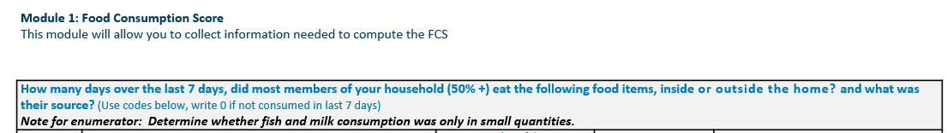
Fcs MODULE: MAIN QUESTION
The FCS module asks respondents how many days, in the last 7 days, did most members of their households (+50%) consume each of the food items/groups, inside or outside their home.
The module has been adapted to help enumerators quantify “most members in a household” and also capture the eating habits of households in urban settings, where consumption outside household is more frequent than rural areas.

Slide 12
Fcs MODULE: MAIN QUESTION (continued)
The recall period of the consumption of different food groups is the last/previous 7 days or a week from the interview date. For example, if today is Wednesday, we would be asking about the period from Tuesday last week to yesterday.

Slide 13
Food Groups & Nutritional Importance

Slide 14
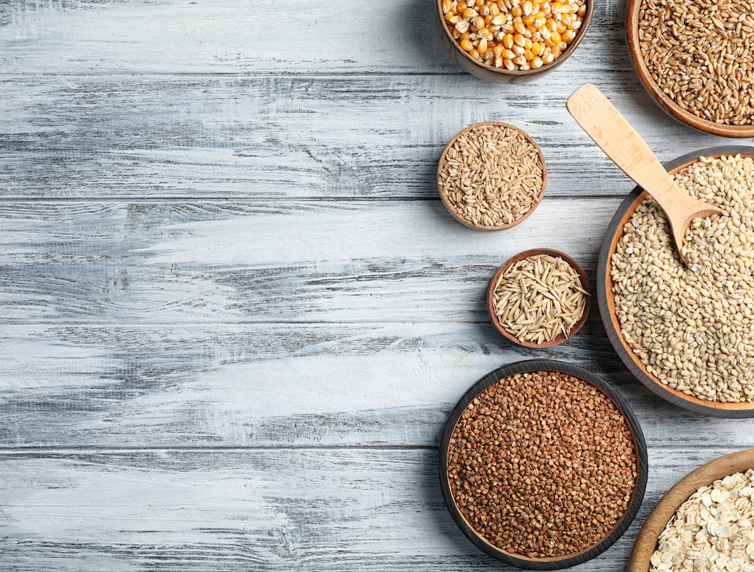
Fcs Food group 1: Staple Foods
Food staples (cereals, grains, roots and tubers) are eaten regularly—even daily—` and supply a major proportion of a person's energy and nutritional needs.
Specific staples vary from place to place, but typically are inexpensive or readily available foods
Standard module example items:
Rice, pasta, bread, sorghum, millet, maize, potato, yam, cassava, white sweet potato.
Notes:
Some of the leading food staple items around the world are cassava, maize, plantains, potatoes, rice, sorghum, soybeans, sweet potatoes, wheat, and yams.

Slide 15
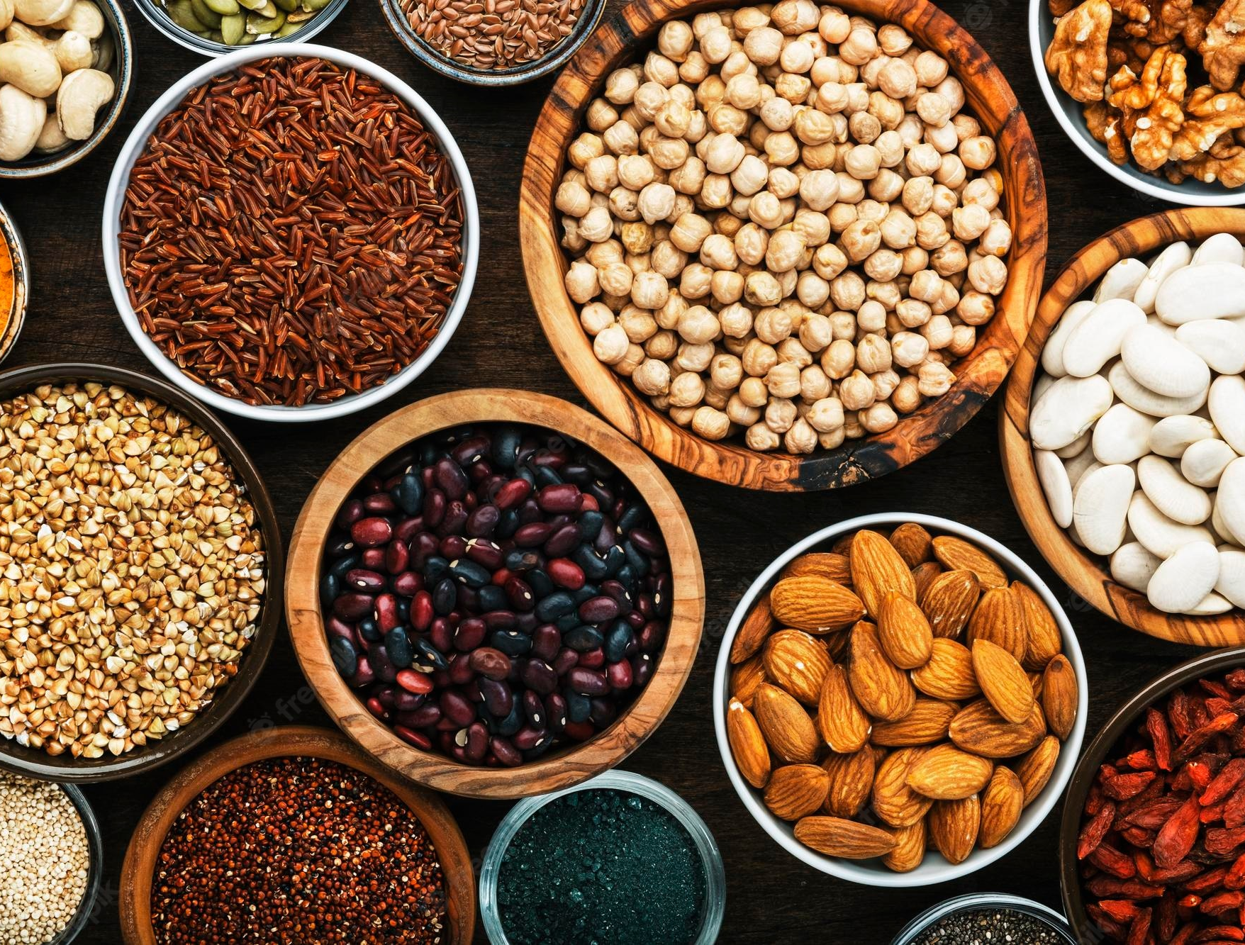
Fcs Food group 2: Pulses, Legumes, nuts
Pulses, also known as legumes, are the edible seeds of leguminous plants cultivated for food.
They are relatively sustainable and inexpensive, rich in protein and fiber.
Dried beans, lentils, peas and nuts are the most known and consumed types of pulses.
Standard module example items:
beans, cowpeas, peanuts, lentils, nuts, soy, pigeon pea and/or other nuts

Slide 16
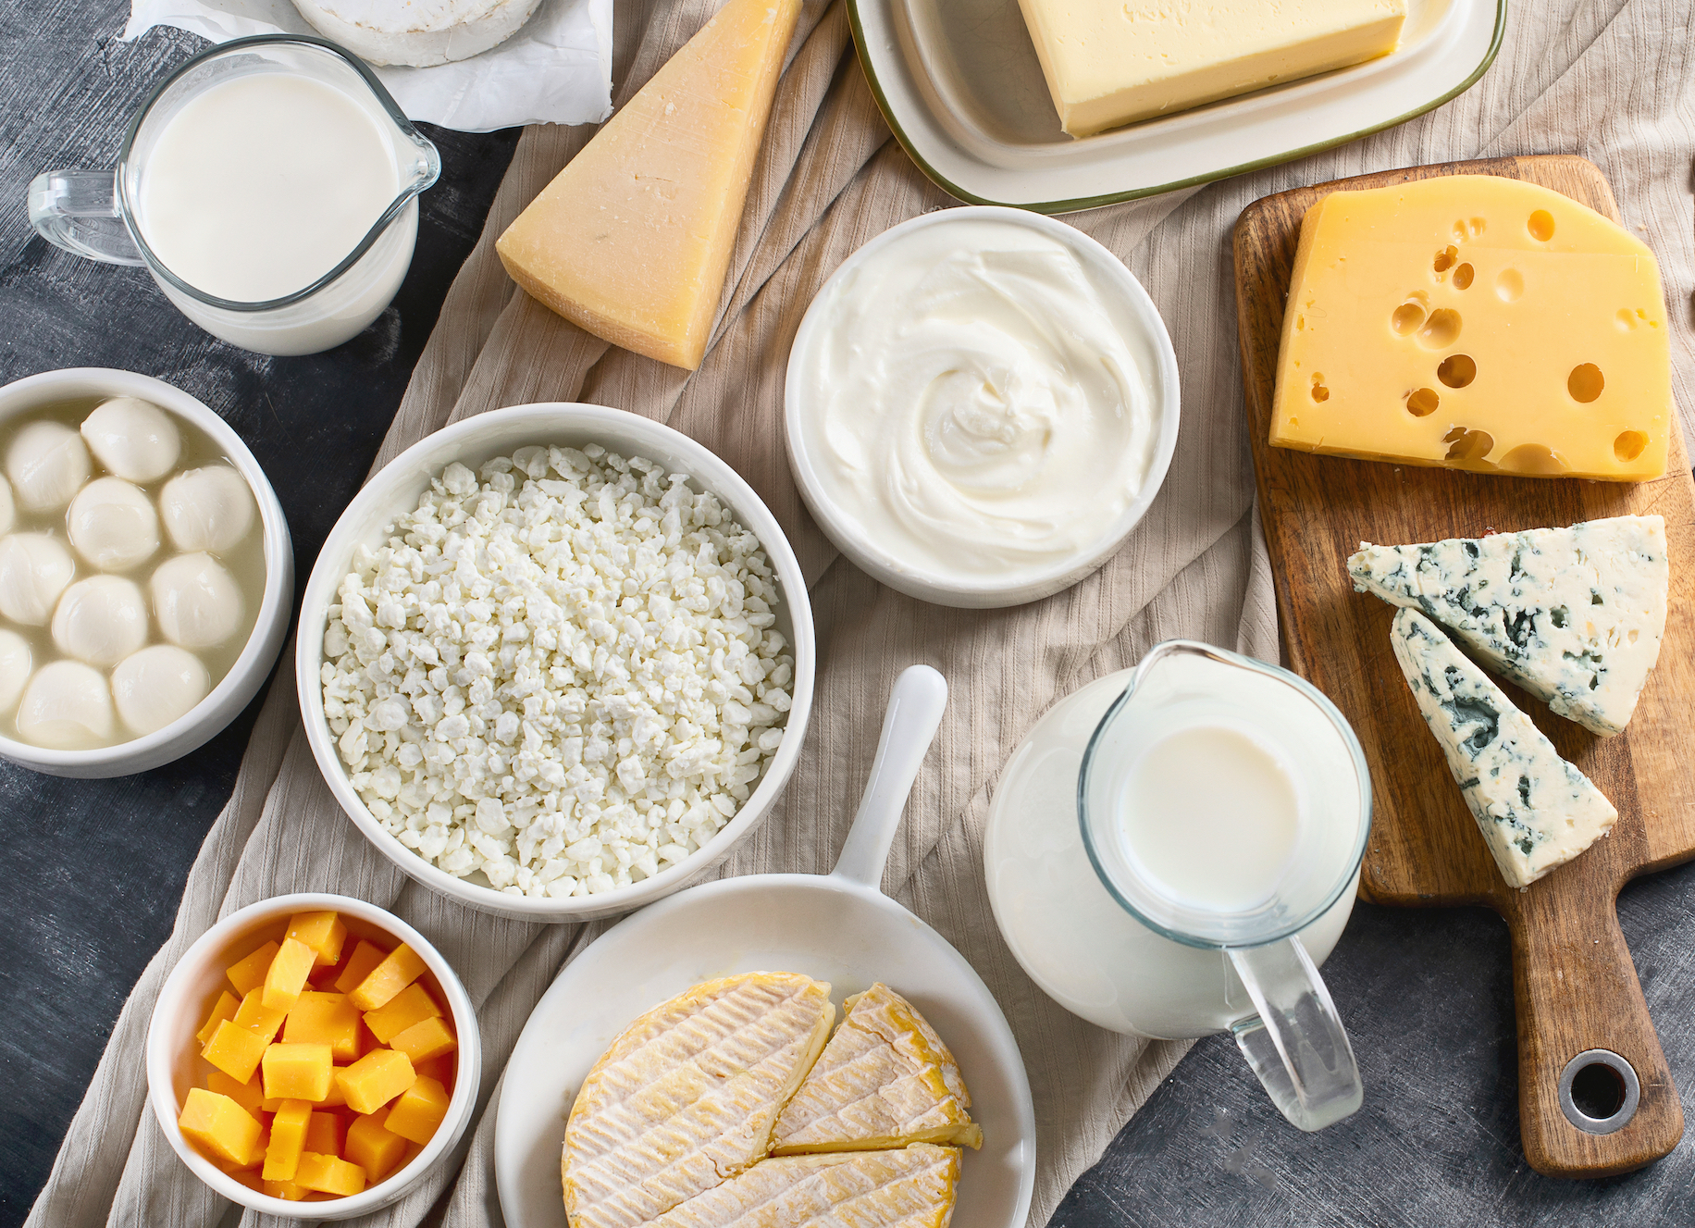
Fcs Food group 3: Milk & dairy products
Codex Alimentarius defines a milk product as a “product obtained by any processing of milk, which may contain food additives, and other ingredients functionally necessary for the processing”.
Standard module example items:
Fresh milk / sour, yoghurt, cheese, and other dairy products
Exclude margarine or butter and small amounts of milk in tea and coffee
Notes:
https://www.fao.org/dairy-production-products/products/en/

Slide 17
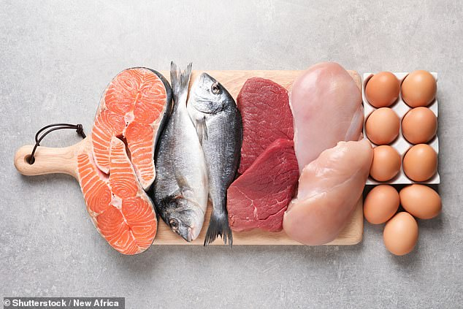
Fcs Food group 4: meat, fish, eggs
Poultry meat and eggs are among the animal-source foods most widely eaten at the global level, across greatly diverse cultures, traditions and religions.
Fresh or canned meats and fish are accounted for.
Standard module example items:
MEAT: goat, beef, chicken, pork
FISH: fish, including canned tuna, escargot, and/or other seafood
EGGS
Meat, fish and eggs consumed in small quantities, as a condiment, are not considered
Notes:
https://www.fao.org/poultry-production-products/products-processing/en/

Slide 18
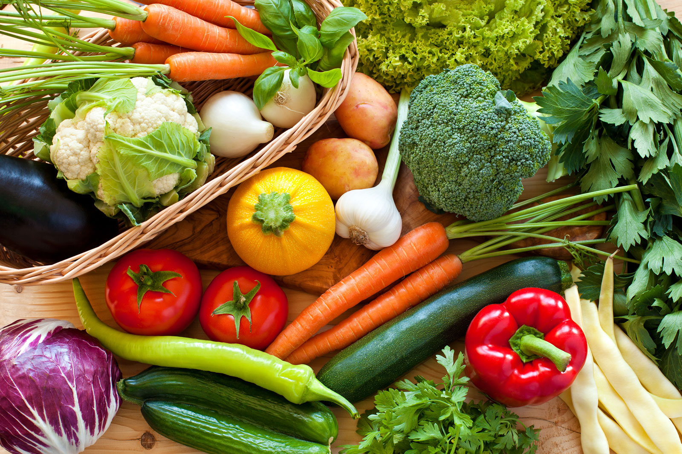
Fcs Food group 5: Vegetables & leaves
Vegetables are considered edible parts of plants (e.g., seedbearing structures, flowers, buds, leaves, stems, shoots and roots), either cultivated or harvested wild, in their raw state or a minimally processed form.
Standard module example items:
Spinach, onion, tomatoes, carrots, peppers, green beans, lettuce, etc.

Slide 19
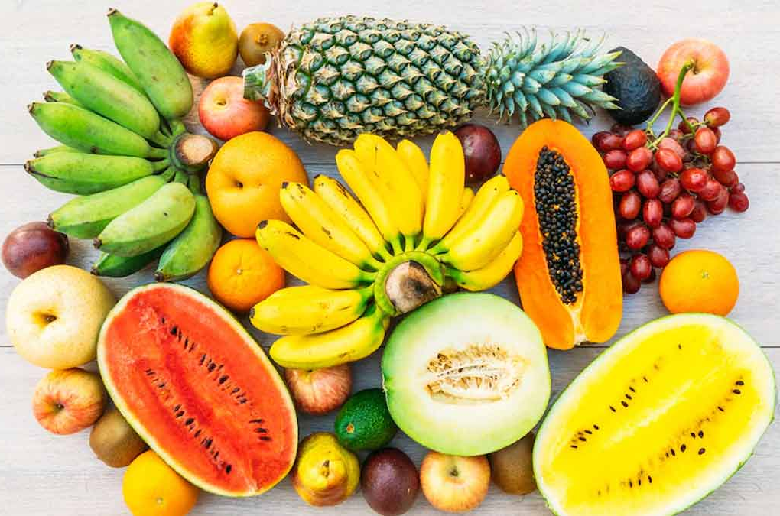
Fcs Food group 6: fruits
Fruits are considered edible parts of plants (e.g., seedbearing structures, flowers, buds, leaves, stems, shoots and roots), either cultivated or harvested wild, in their raw state or a minimally processed form.
Standard module example items:
Bananas, apples, lemon, mango, papaya, apricot, peach, etc.

Slide 20

Fcs Food group 7: OIL, FAT, BUTTER
Butter is considered a solid saturated fat, and oil is considered a liquid unsaturated fat.
Oil is generally healthier compared to fats/butter, but we account for both the same way in FCS.
Standard module example items:
Vegetable oil, ghee, palm oil, shea butter, margarine, and other fats/oil.

Slide 21
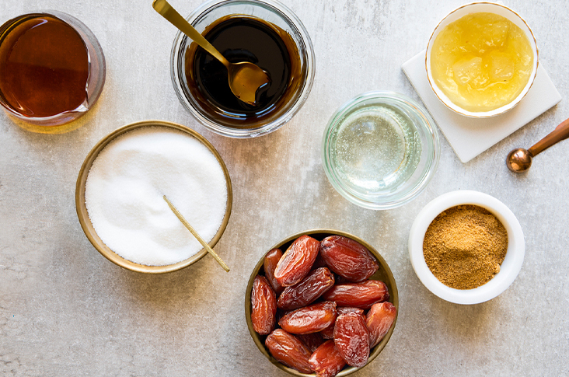
Fcs Food group 8: Sugar, sweets
Sugar and sweets are soluble carbohydrates and are high in glucose.
All types of sweeteners and desserts are accounted for the same under this FCS food group.
Standard module example items:
Sugar, honey, jam, cakes, candy, cookies, pastries, cakes and other sweet (sugary drinks).

Slide 22
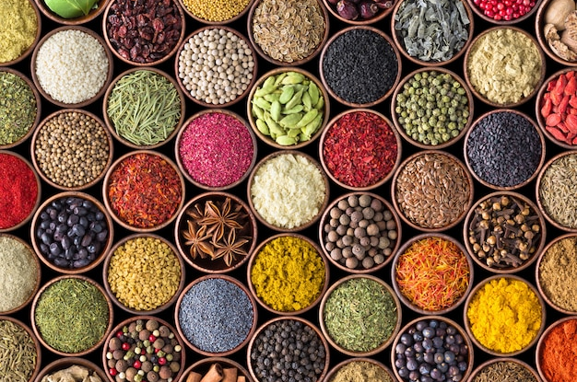
Fcs Food group 9: condiments, spices
Condiments are supplemental food (such as a sauce or powder) that are added to some foods to enhance the flavour, improve taste, or, in some cases, complement the dish, but cannot stand alone as a dish.
The condiments food group is mainly included to help capture foods consumed in very small quantities, as condiments, and avoid inclusion under nutritious food groups.
Standard module example items:
Tea, coffee, cocoa, salt, garlic, spices, yeast, baking powder, tomato sauce. Condiments such as small amounts of meat or fish and milk are used to adjust the taste of foods or drinks.

Slide 23
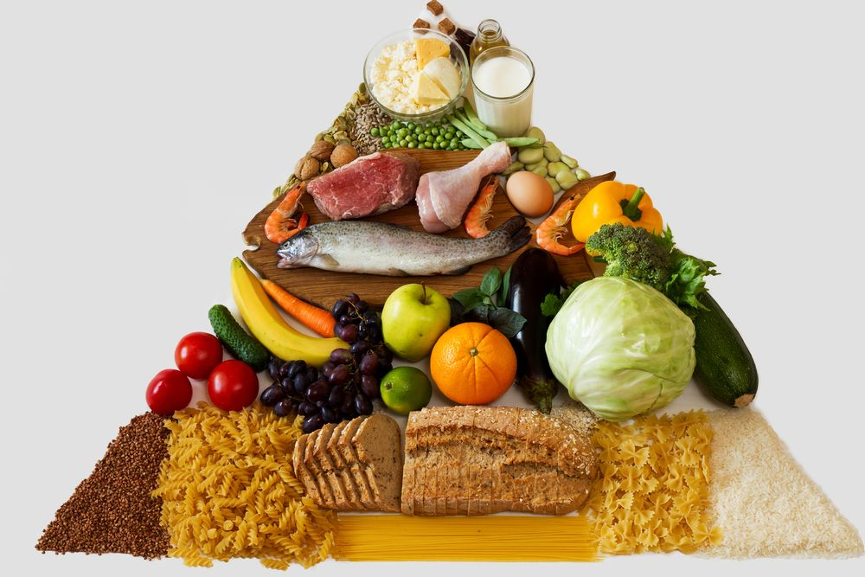
Food group weights
Sugar & sweets: 0.5
Oils, fat, butter: 0.5
Milk & dairy: 4.0
Pulses, legumes & nuts: 3.0
Meat, fish & eggs: 4.0
Fruits: 1.0
Vegetables & leaves: 1.0
Staples foods: 2.0

Slide 24
Food Groups (definitive) | Food Items (examples) | Weight | Justification
Meat, Fish & Eggs | Beef, goat, poultry, pork, fish & eggs | 4 | Highest quality protein, easily absorbable micronutrients (no phytates), energy-dense, fat. Even when consumed in small quantities, improvements to the quality of the diet are large.
Milk | Milk, yoghurt, cheese & other dairy products | 4 | Highest quality protein, micro-nutrients, vitamin A, energy. However, milk could be consumed only in very small amounts and should then be treated as condiment and therefore re-classification in such cases is needed.
Pulses | Legumes/nuts (e.g.: Beans, peas, lentils, nuts, soy, cowpea, peanuts, &other nuts) | 3 | Energy-dense, high amounts of protein but of lower quality (PER less) than meats, micro-nutrients (inhibited by phytates), low fat.
Staples | Cereals, grains, roots & tubers (eg: maize, maize porridge, rice, sorghum, millet pasta, bread & other cereals), sweet potato, taro | 2 | Energy dense/usually eaten in larger quantities, protein content lower and poorer quality (PER17 less) than legumes, micro-nutrients (bound by phytates).
Vegetables | Vegetables & leaves | 1 | Low energy, low protein, no fat, micro-nutrients
Fruits | Fruits | 1 | Low energy, low protein, no fat, micro-nutrients
Oil | Oil/fat/butter | 0.5 | Energy dense but usually no other micro-nutrients. Usually consumed in small quantities
Sugar | Sugar and sugar products, honey, sweets | 0.5 | Empty calories. Usually consumed in small quantities.
Condiments | Spices, tea, coffee, salt, fish powder, small amounts of milk for tea. | 0 | These foods are by definition eaten in very small quantities and not considered to have an important impact on overall diet.

Slide 25
HOW TO ASK?

Slide 26
Fcs MODULE: how to ask
“In the past or over the past 7 days, how many days did most of your household members consume this food group (give examples for each food group) inside or outside the home?”
IMPORTANT: When asking the question, you ask how many days NOT how many times, as household members may consume the same food group for example 3 times on the same day, and this will be considered as 1-day consumption from the same group.
Notes:
E.g., If a household consumed eggs at breakfast and meat at lunch on the same day, this is considered as one day of animal protein consumption (meat, egg, fish). Similarly, if a household consumed bread every day in the past 7 days this is considered a 7 day of cereals consumption regardless if they consumed rice or any other cereal products or not

Slide 27
Fcs MODULE: how to ask
“In the past or over the past 7 days, how many days did most of your household members consume this food group (give examples for each food group) inside or outside the home?”
IMPORTANT: You must ask about the days consumed in the past week/7 days. Sometimes households or respondents may get confused and answer about their purchases. For example, a household bought meat in the past 7 days but didn't consume any of it in the past 7 days. This information must not be captured under the FCS module.

Slide 28
Fcs MODULE: how to ask
“In the past or over the past 7 days, how many days did most of your household members consume this food group (give examples for each food group) inside or outside the home?”
IMPORTANT: To help in quantifying the majority of a household, consider 50% of the household members or more.

Slide 29
Fcs MODULE: how to ask
“In the past or over the past 7 days, how many days did most of your household members consumed this food group (give examples for each food group) inside or outside the home?”
IMPORTANT: Consumption of food outside or inside the home is both accounted for, as long as the foods are consumed by 50%+ of household members, and of acceptable quantities.

Slide 30
Fcs: other considerations
Small insufficient quantities consumed by household members would NOT be included as consumed food on a specific day, the following table will guide you on how to determine if the food consumed is insufficient or small.
Consumption of foods acquired through assistance must be reflected in the data collection. Other indicators and modules should reveal the provision of assistance (e.g., demographics, FCS’s food sources, expenditures, humanitarian assistance modules)

Slide 31
FCS: training instructions 3
During the interview, it is vital that the enumerators stress on quantities consumed, as respondents may mention consuming protein-rich foods such as milk, eggs, meats and fish, when in reality – any of these items could be consumed as condiments.
Small quantities mustn’t be considered, which needs to be also stressed during the enumerators’ training.
Quantities of foods that cannot be a standalone dish for the family are to be recorded under condiments, not the main food groups.
Quantity of foods must be evaluated during data collection, but not the quality.

Slide 32
Food items/groups | Examples/scenarios of small quantities consumed
Meat, chicken, fish | One small piece (like a box of matches) for 3 or more persons | Fish powder spread over meals | A piece to add flavour to a soup
Eggs | One egg for 4 or more persons | Eggs used only as condiment
Milk | A pinch of milk added to tea and/or coffee | A single glass or cup for 3 or more persons | A spoon of powdered milk added to coffee/tea
Cheese | A little grated cheese spread over meals | A small piece (like a box of matches) for 4 or more persons
Vegetables | One or two tomatoes or onions used as condiment | Cauliflower and/or carrot consumed only as pickle | only a half/ small unit for 4 or more people | Leaves: a few leaves for all
Fruits | Fruits used to flavour refreshments (like a lemon slice added to a drink) | Only one unit for 4 or more persons | A single date is consumed by each household member.
Oil | A spoon or less
Notes:
E.g., If a household reported consuming fish on a particular day in the last 7 days, then enumerators must probe to understand the quantities consumed. First by asking whether it was consumed by the majority of the household and if yes, then was it the main ingredient of the meal or used as a condiment? And can it be a stand-alone dish for the household? Or is it used to adjust the flavour of the meal? If used to adjust the flavour then it can only be reported under condiments.

Slide 33

PROBING examples
Probing questions should be applied during interviews to better understand unusual household food consumption information.
For example, if the number of consumption days reported under most food groups in the FCS module is too low or too high, depending on the normal access and availability to households in a given context, then a qualitative follow-up question should appear – such as
"Why was the consumption of staples less than 4 days?"

Slide 34

Enumerator’s notes
Enumerators and field supervisors should take notes about any irregular consumption patterns that may stand out during the pilot or actual data collection phases.
Any qualitative information that would explain the quantitative data, or that would trigger adjustments, such as for the food items in the FCS module.
Enumerators’ notes should be presented and discussed during debriefing sessions, along with observational information.

Slide 35
How do the food groups come together?

Slide 36
FCS: CALCULATION example
Multiply the value obtained for each food group by its weight and sum the weighed food group scores, thus creating the food consumption score.
Food groups | Frequency of consumption | Weights | Frequency x weight
Cereals, grains, roots and tubers | 7 | 2 | 14
Legumes/ nuts | 2 | 3 | 6
Milk and other dairy products | 3 | 4 | 12
Meat, fish and eggs | 2 | 4 | 8
Vegetables and leaves | 2 | 1 | 2
Fruits | 1 | 1 | 1
Oil/fat/butter | 7 | 0.5 | 3.5
Sugar, or sweet | 7 | 0.5 | 3.5
Condiments | 7 | 0 | 0
Sum of score |  |  | 50
Compute FCS = sum(FCSStap*2, FCSPulse*3, FCSDairy*4, FCSPr*4, FCSVeg*1, FCSFruit*1, FCSFat*0.5, FCSSugar*0.5).

Slide 37
FCS: CALCULATION example (continued)
Using the appropriate thresholds, recode the variable food consumption score, from a continuous variable to a categorical variable.
Cut-off thresholds are applied to the FCS to classify households into three groups: poor, borderline or acceptable food consumption. These food consumption groups aggregate households into the following three categories:
Categories | Thresholds | Adjusted thresholds*
Poor food consumption | 0-21 | 0-28
Borderline food consumption | 21-35 | 28.5-42
Acceptable food consumption | >35 | >42
*Used in contexts where the consumption of oil and sugar are high. Consult with your CO VAM Officer and/or RMEA on applicable thresholds in your country or region.

Slide 38
Module Design

Slide 39
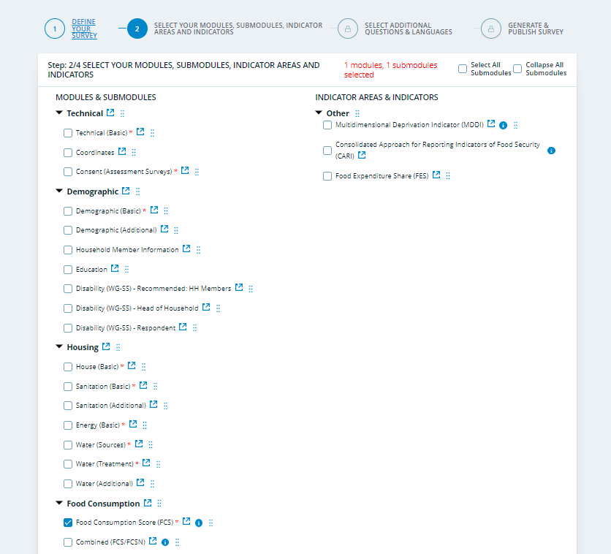
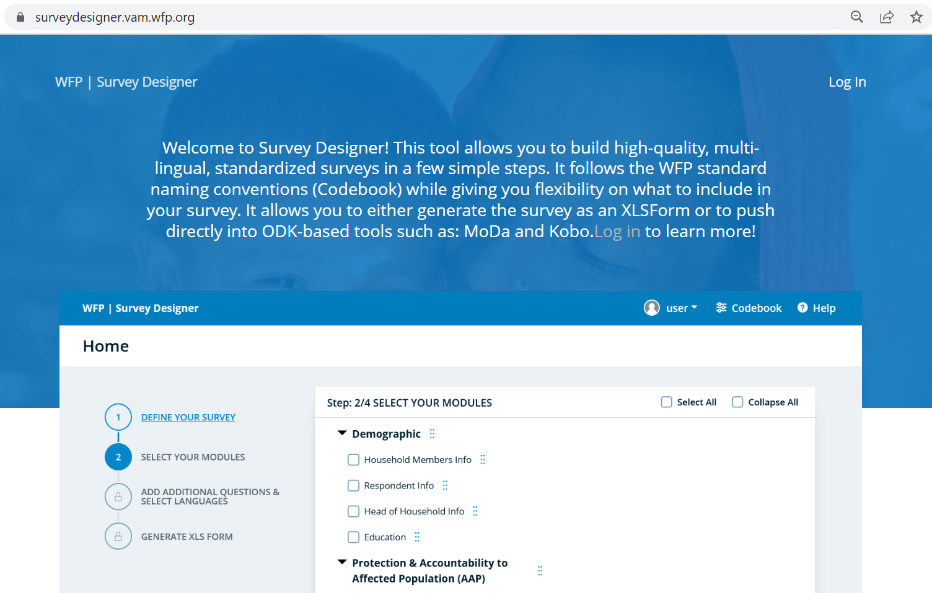
FCS: Survey Designer
FCS Codebook (Survey Designer)

Slide 40
FCS Module design
When designing your questionnaire, including the FCS module, please refer to the Survey Designer as it offers the WFP’s standard modules in XLSform and word formats.
Slight adjustments can be made to the offered single food items to reflect the most common local food items.
If you have to rely on data collection tools and platforms that do not support XLSforms then you must replicate the standard module correctly, including the visibility and validation constraints.
Notes:
If this opportunity is missed during the data cleaning phase, data analysts must ensure data quality through the triangulation of responses. Refer to the data quality assurance guidance note for more information.

Slide 41
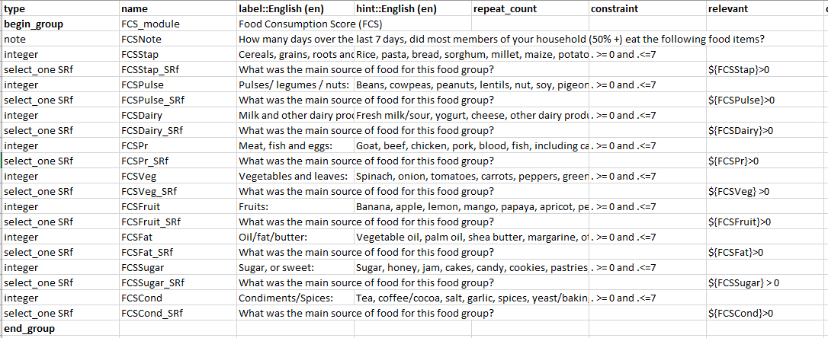
FCS: Survey Designer
Food items that can be adjusted for local context

Slide 42
Data quality checks

Slide 43
Quality check examples
Run simple frequencies of the days of consumption of each food group to help understand the general food consumption patterns. For example, this could show that the entire population consumes high levels of oil and sugar.
Closely examine data to highlight and resolve any errors or inconsistencies. This includes checking the data for missing, inconsistent, out-of-range values, spelling mistakes, and erroneous categorizations.
Compare the mean FCS and the mean number of days of consumption of the different food items/groups by enumerator, administrative levels and/or stratum, to detect unusual values/results.

Slide 44
FCS: descriptives and frequencies
Closely examine the data records to highlight and resolve any errors or inconsistencies by running descriptive analyses (frequencies, min, max, mean, mode) on each of the variables in the FCS section. This includes checking FCS data for missing values, inconsistencies, out-of-range values (when 0-7 constraints hadn't been set), and wrong categorizations (i.e., food sources).
Secondly, understanding the spread of variance by graphing the distribution in the dataset.

Slide 45
FCS: descriptives and frequencies example
DESCRIPTIVES VARIABLES=FCSStap FCSPulse FCSDairy FCSPr FCSVeg FCSFruit FCSFat FCSSugar FCSCond
/STATISTICS=MEAN STDDEV MIN MAX.
Descriptive Statistics
 | N | Minimum | Maximum | Mean | Std. Deviation
FCSStap | 6859 | 0 | 7 | 6.72 | 0.930
FCSPulse | 6859 | 0 | 7 | 3.24 | 1.980
FCSDairy | 6859 | 0 | 7 | 4.31 | 2.392
FCSPr | 6859 | 0 | 7 | 4.71 | 2.292
FCSVeg | 6859 | 0 | 7 | 4.97 | 2.203
FCSFruit | 6859 | 0 | 7 | 4.07 | 2.394
FCSFat | 6858 | 0 | 7 | 5.89 | 2.041
FCSSugar | 6859 | 0 | 7 | 3.90 | 2.644
FCSCond | 6833 | 0 | 7 | 3.26 | 2.977
Valid N (listwise) | 6832

Slide 46
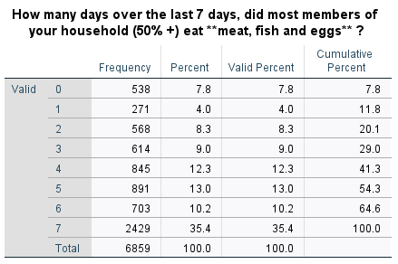
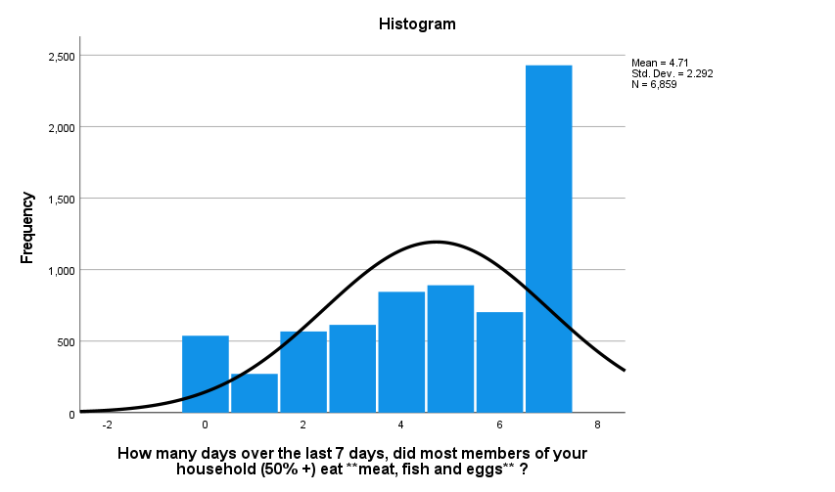
FCS: descriptives and frequencies example
FREQUENCIES VARIABLES=FCSPr
/HISTOGRAM NORMAL
/ORDER=ANALYSIS.
Repeat this step for all food groups

Slide 47
FCS: examine data/zero values
Unusual zero values, whether across cases or commonly consumed groups (i.e., cereals and pulses) must be investigated at both the dataset level and field levels, to ensure that households did not consume any of these groups. As zero consumption usually appears in catastrophe or famine situations.
Make a judgement call on the data quality after investigating such red flags.

Slide 48
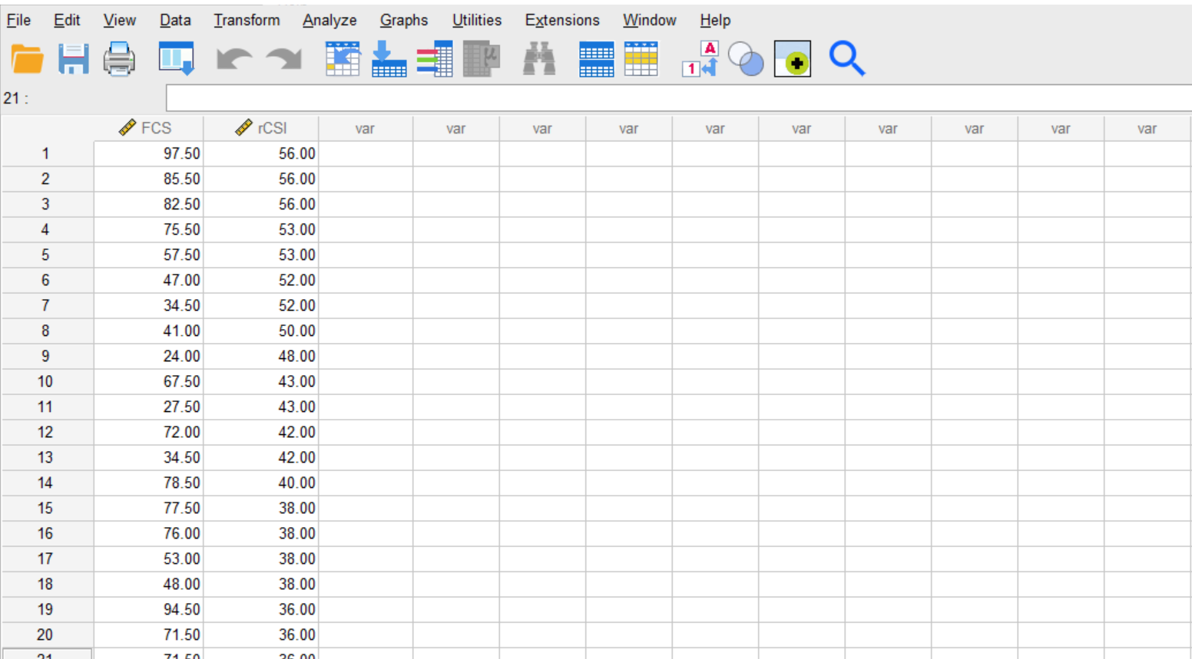
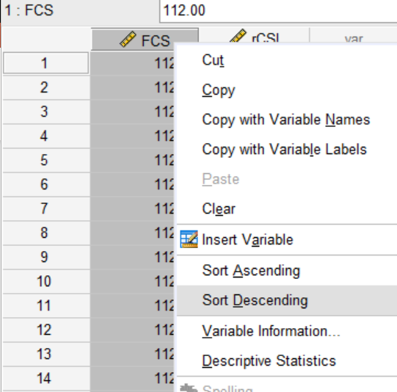
FCS: examine data /correlations
Investigate with other highly correlated indicators such as rCSI.
e.g., HHs with high FCS and high rCSI

Slide 49
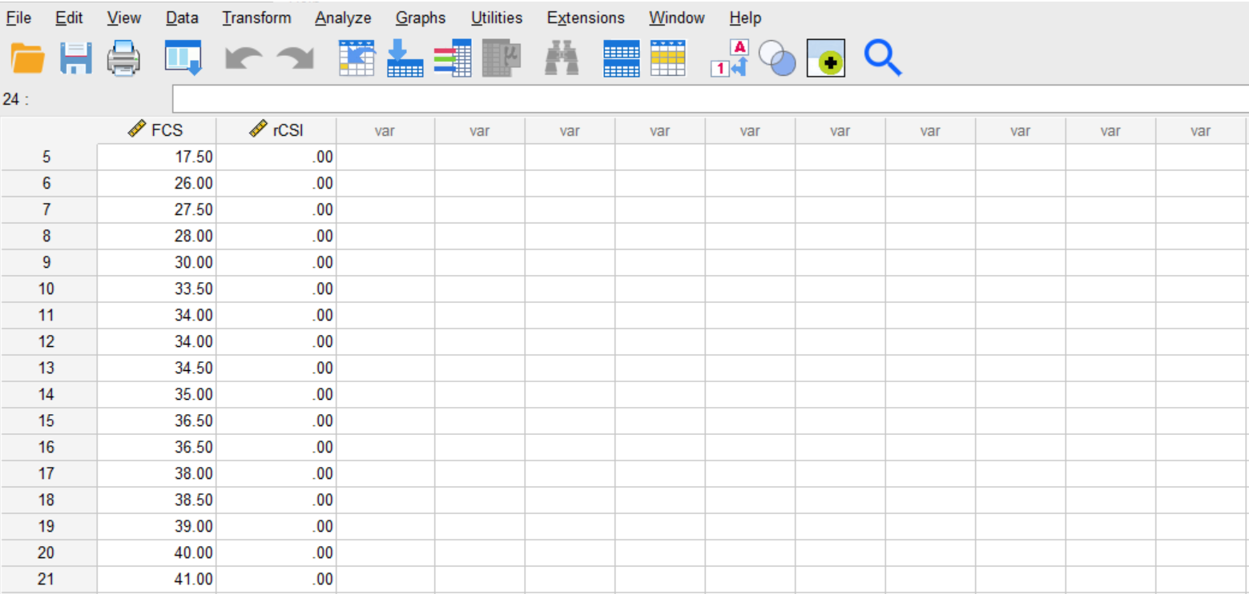
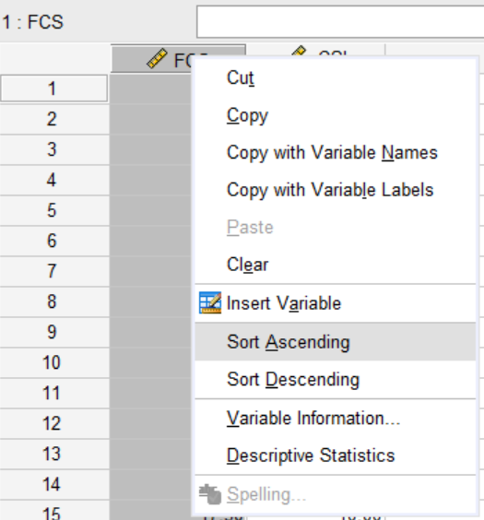
FCS: examine data /correlations
Investigate with other highly correlated indicators such as rCSI.
e.g., HHs with low FCS and low rCSI
Again, make a judgement call on the data quality after investigating such red flags.

Slide 50
FCS: Data cleaning/Missing & out-of-range values
In case the questionnaire/database was not programmed correctly, a larger amount of missing data or nonresponse rates should be anticipated, hence appropriate measures to address the missing and out-of-range data should be considered such as case trimming or imputation depending on the amount of data missing.
Depending on the size of data with issues, options are:
In the case of missing values, do not replace them but drop such cases from your analysis.
In case of more than 7 values (days of consumption) trim the values down to 7 days.

Slide 51
Analysis

Slide 52
FCS: Survey Designer
Find the latest standard FCS module in XLSform on
Survey Designer

Slide 53
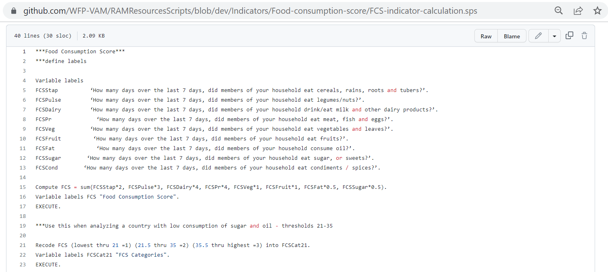
FCS: GITHUB
Find the SPSS, STATA and R scripts on
GitHub WFP RAM

Slide 54
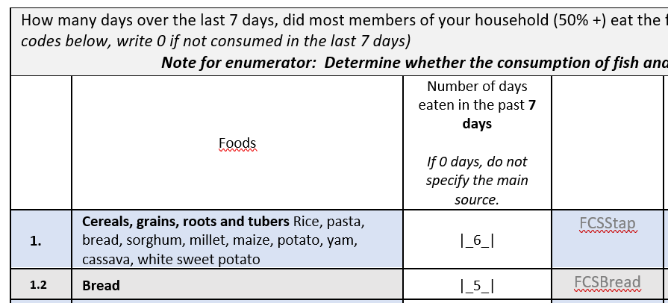
FCS: CALCULATION lookouts
IMPORTANT: If more than eight food groups such as the FCS-N module (16 food groups) are collected, then the main eight food groups must be asked in an aggregated way before disaggregation. FCS must be calculated from the direct answers on the consumption of the aggregated eight food groups.
The frequency value for this food group is 6 and must not be aggregated to 7.

Slide 55
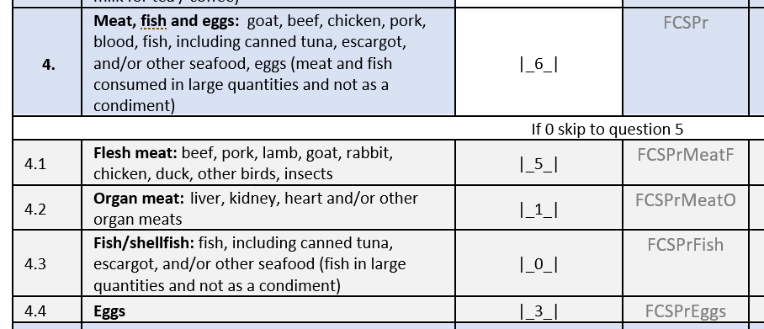
FCS: CALCULATION lookouts
Because guess what! For the FCS calculation, we only care about the number of days when the main food groups were consumed.
EXAMPLE:
In the last 7 days, most members of the household consumed flesh meat items for lunch, on 5 different days.
The household indicated that they also had eggs in the morning of these days when they consumed flesh meat items.
On a different day, they had organ meat items for dinner.

Slide 56
Reporting

Slide 57
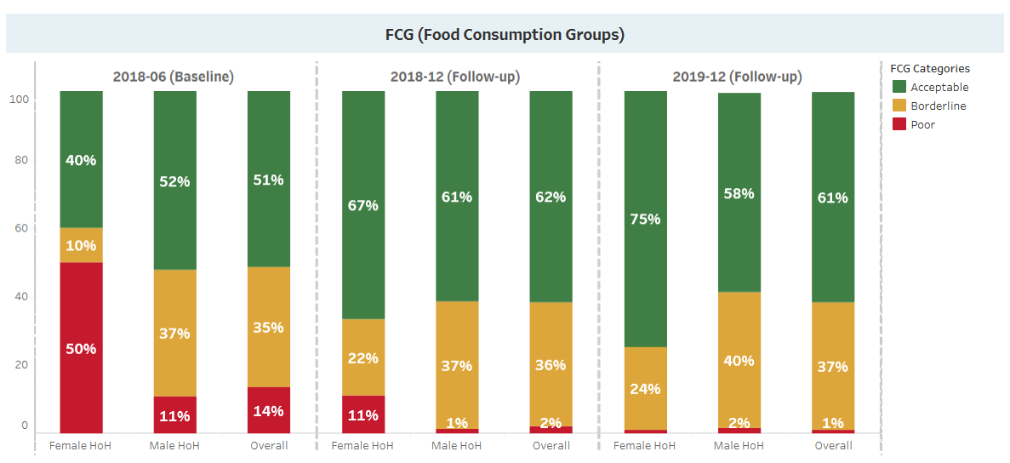
FCS: REPORTING EXAMPLE
Notes:
When monitoring beneficiaries of WFP programme activities, it is expected that the proportion of households with poor and borderline consumption decreases and the proportion of households with acceptable consumption increases following the receipt of food assistance.

Slide 58
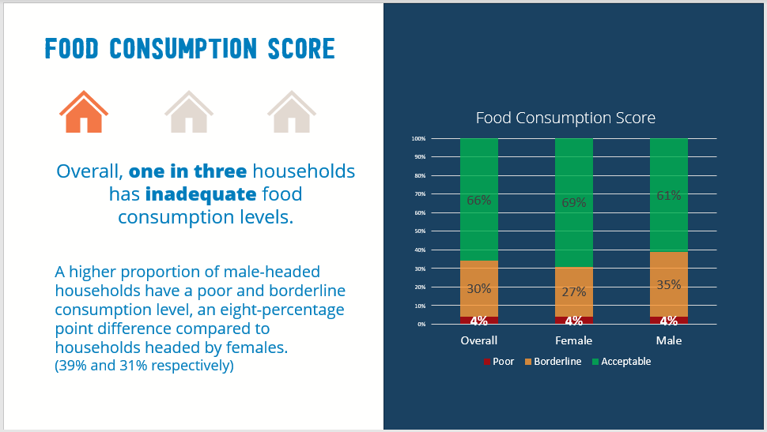
FCS: REPORTING EXAMPLE

Slide 59
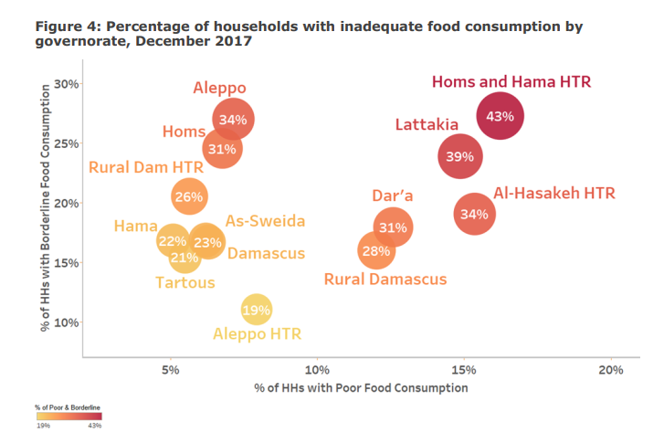
FCS: REPORTING EXAMPLE

Slide 60
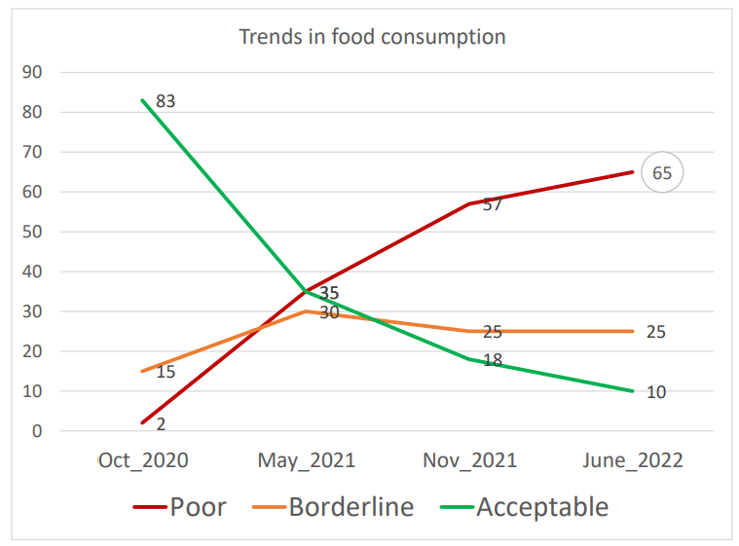
FCS: DON’T’S IN REPORTING

Slide 61
Food Sources

Slide 62
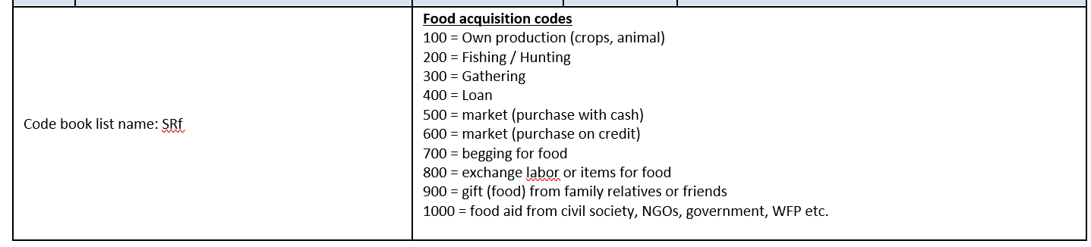
FCS: food sources
Less emphasis is normally placed on the component related to sources of food in the FCS module, which has great importance in explaining the food security situation of households and their current capacity.

Slide 63
FCS: food sources
Food source | Description
Own production (crops, animals) | Households mostly obtained this food from their own production of crops or animals. It could indicate some level of dependency, subject to the local setting (urban/rural). This food source could be triangulated with food expenditures for data quality checks and verifications.
Fishing/ hunting | Households mostly obtained this food from activities such as fishing and/or hunting. It could indicate some level of dependency, subject to the local setting (urban/rural). This food source could be triangulated with food expenditures for data quality checks and verifications.
Gathering | Households mostly obtained this food through gathering activities. It could indicate a level of despair.
Loan (including borrowed, credited) | Households mostly obtained this food by borrowing. If a household report having ‘borrowed food’ as the main food source, this reflects a situation in which the household must repay the lender at some future point in time (with food or money).
Market (purchase with cash) | Households mostly obtained this food through purchases at formal or informal markets using cash. This food source could be triangulated with food expenditures for data quality checks and verifications.
Market (purchase on credit) | Households mostly obtained this food through purchases at formal or informal markets using credit. This food source could be triangulated with food expenditures for data quality checks and verifications.
Begging for food | Households mostly obtained this food through begging. If a household’s main source of food purchases but the cash used to purchase the food was obtained by begging, then the main source recorded should be ‘begging’. If commonly applied, then may be worth including the begging livelihood coping strategy in that specific module.
Exchange for labour or items for food | Households mostly obtained this food as payment for work.
Gift (food) from family, friends | Households mostly obtained this food as gifts from friends and family. This food source could be triangulated with food expenditures for data quality checks and verifications.
Food aid from civil society, NGO, government, WFP, etc. | Households mostly obtained this food in the form of aid from civil society, NGOs, or the government. This food source could be triangulated with food expenditures and humanitarian assistance sections for data quality checks and verifications.

Slide 64
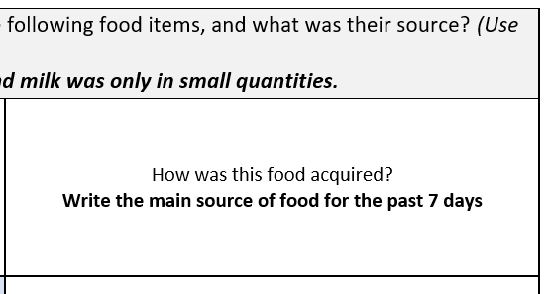
FCS: food sources
The food source column of the food consumption module is used to record the main method by which the household obtained each recorded food item/group.
The module is designed to collect food sources linked directly to the different food items/groups.
In situations where a household states that a particular food group was sourced equally from two or more main sources, the enumerator must probe to determine which source provided the highest share of the foods belonging to that food group.

Slide 65
Food sources: Survey Designer
Find the latest standard FCS module in XLSform on
Survey Designer

Slide 66
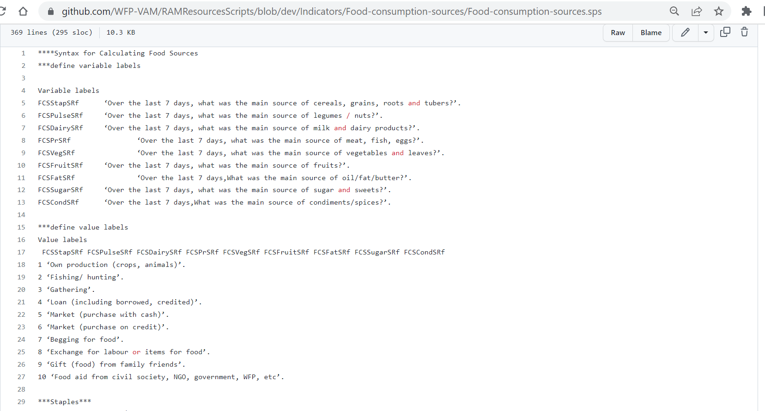
Food sources: GITHUB
Find the SPSS, STATA and R scripts on
GitHub WFP RAM

Slide 67
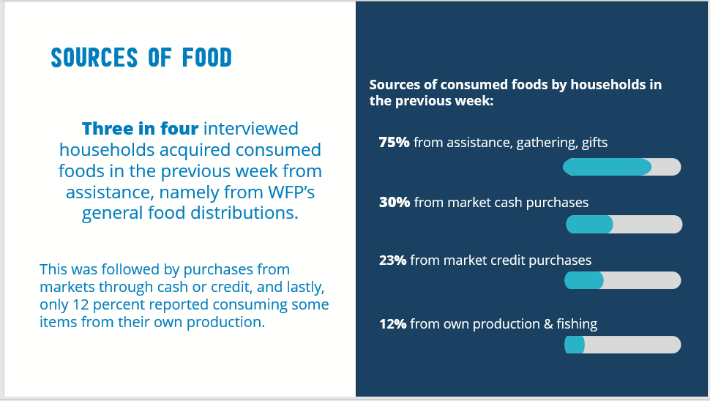
FCS: food sources

Slide 68
Available Resources

Slide 69
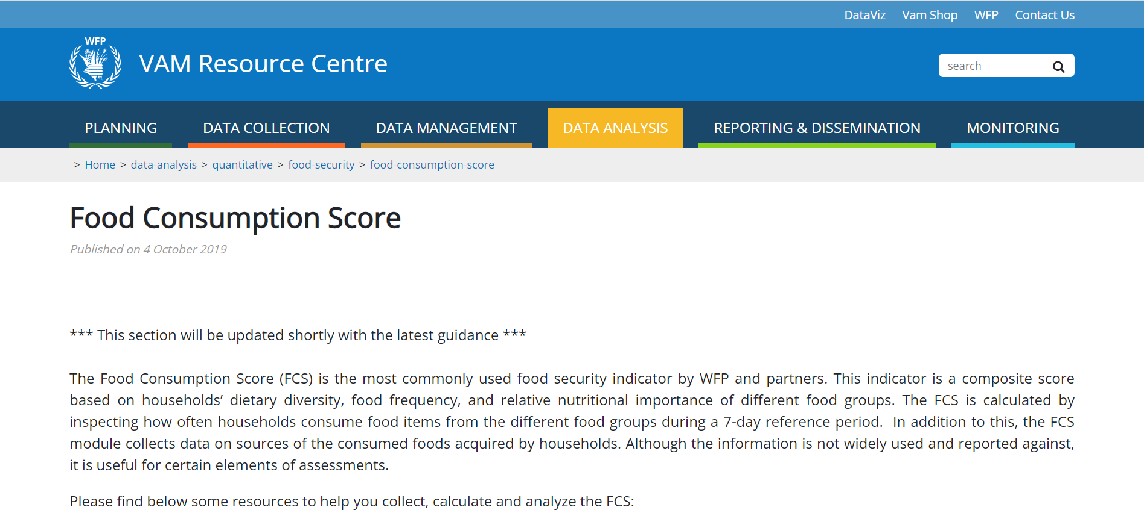
FCS: VAM Resource Centre
For more information and guidance go to
FCS (Resource Centre)

Slide 70
Thank You!

